Slide 1
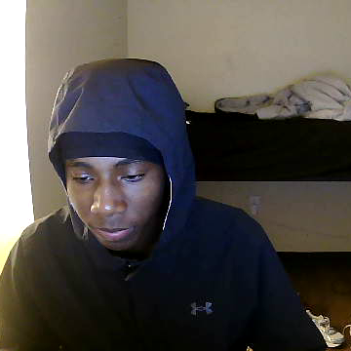
Demo Speech
Jacobi Jones

Slide 2


Introduction

Slide 3
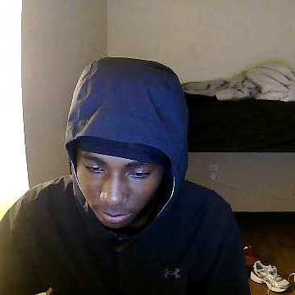
What is Quizlet?
Quizlet is a popular study app offering tools to help people learn, including digital flashcards, matching games, practice assessments, and live quizzes.

Slide 4
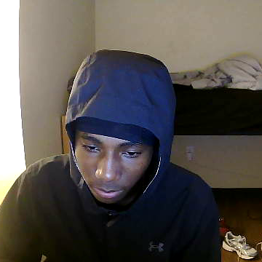
When was it founded?
Quizlet was created in 2005 by Andrew Sutherland, a high school student, to help him study for a French vocabulary quiz.

Slide 5
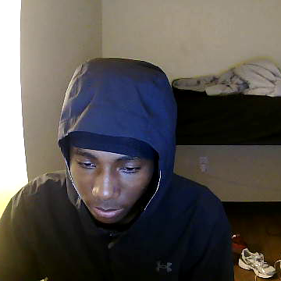
Different study modes
Learn Mode: Adaptively quizzes the user based on their progress and difficulty.
Write Mode: Prompts users to type the correct answer.
Match Mode: A game where users match terms with definitions as quickly as possible.
Test Mode: Generates a quiz from the flashcards with multiple choice, true/false, and written questions.

Slide 6
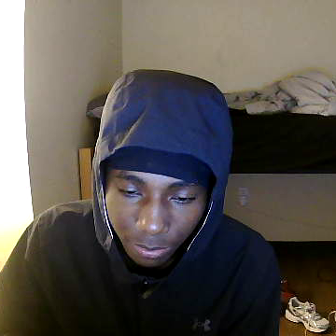
Platforms
It is a web-based platform accessible on both desktop and mobile devices (iOS and Android).

Slide 7
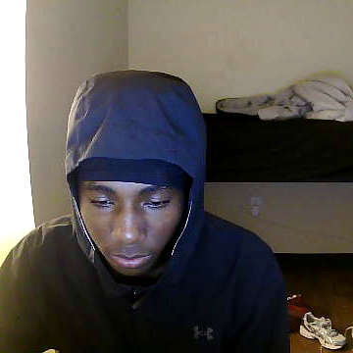
FUn Fact
Did you know Quizlet has been around for 19 years?

Slide 8
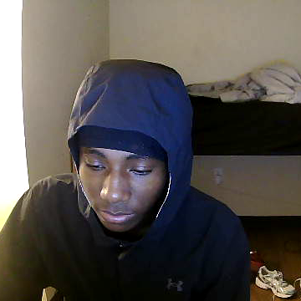
Importance of using Quizlet
The importance of using Quizlet helps the student or user to become memorable in whatever it is they are studying.

Slide 9
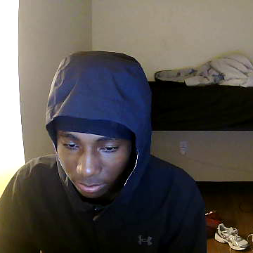
How many people use Quizlet?
Every month, over 60 million students, teachers and everyday people use Quizlet to study any subject imaginable for school, work or as part of their personal interests -- including 2 in 3 high school students and 1 in 2 college students in the US.

Slide 10

How effective is Quizlet?
Quizlet has helped me to increase my Applied Mathematical Reasoning grade to a B+ coming from a D.

Slide 11
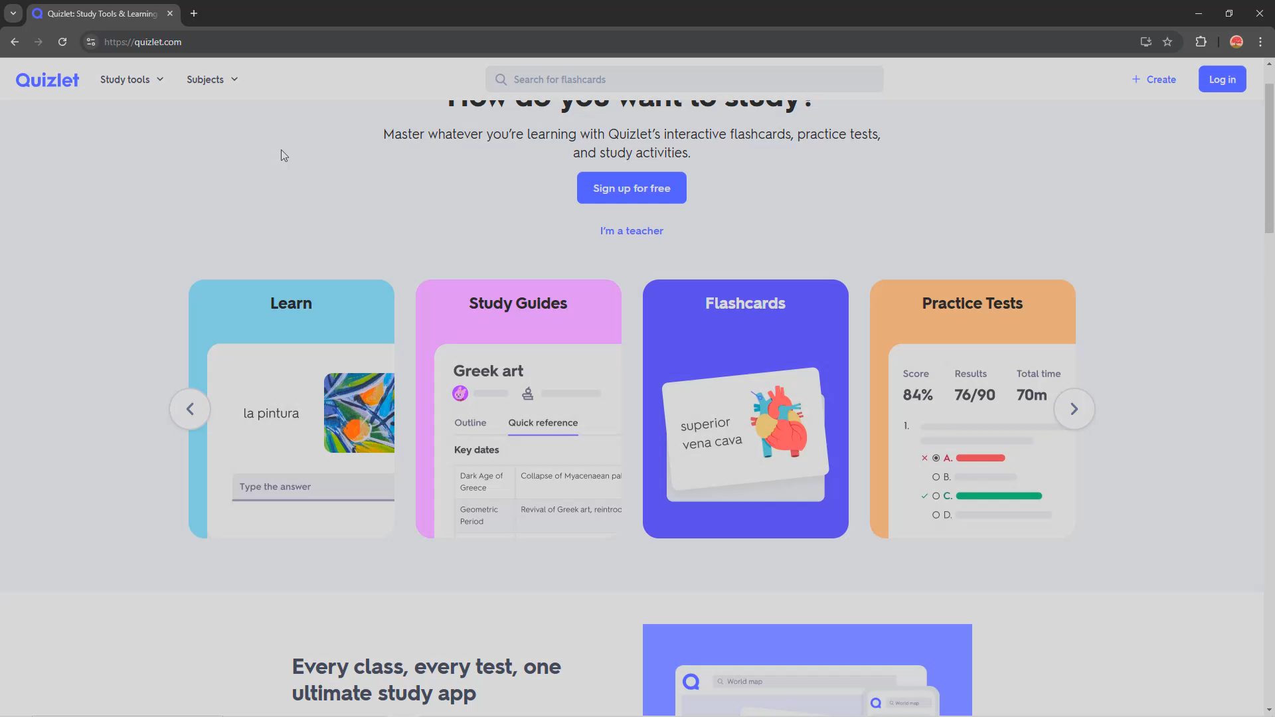

Demonstration Time!

Slide 12
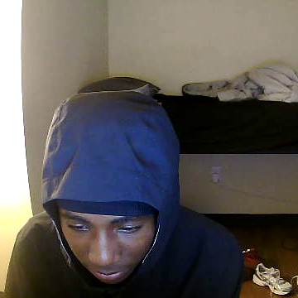
Conclusion
In conclusion, Quizlet is a beneficial tool that can help students to be better at whatever it is they are struggling with or even desire to just become memorable in, so I encourage everyone to use Quizlet.

Slide 13
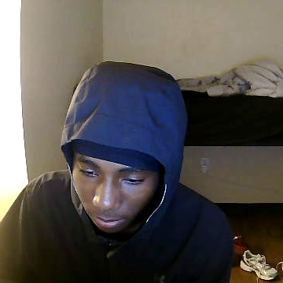
References
A new milestone for Quizlet: 50 million monthly learners | Quizlet. (2018, October 30). Quizlet. https://quizlet.com/blog/a-new-milestone-for-quizlet-50-million-monthly-learners
Quizlet. (2020). PCMAG; PCMag. https://www.pcmag.com/reviews/quizlet
Quizlet. (2024). About Quizlet. Quizlet. https://quizlet.com/mission

